Slide 1
Coupled Multi-Layer Attentions for Co-Extraction of Aspect and Opinion Terms
Wenya Wang, Sinno Jialin Pan, Daniel Dahlmeier, Xiaokui Xiao
Nanyang Technological University, Singapore
许慧敏
2017/12/27

Slide 2
Outline
Background
Model
Experiments

Slide 3
Outline
Background
Model
Experiments

Slide 4
Background
Task: aspect terms and opinion terms co-extraction
Fish burger is the best dish it tastes fresh.

Slide 5
Background
Task: aspect terms and opinion terms co-extraction
Fish burger is the best dish it tastes fresh.

Slide 6
Background
Task: aspect terms and opinion terms co-extraction
Fish burger is the best dish it tastes fresh.

Slide 7
Background
Task: sequence tagging problem
Input: a sentence s = {w_{1,} w_{2,} …, w_{n}}
Output: w_{i} → y_{i} ∈L
L = {BA, IA, BP, IP, O}
BA(beginning aspect)
IA(inside aspect)
BP(beginning opinion)
IP(inside opinion)
O(others)
Fish burger is the best dish it tastes fresh.

Slide 8
Outline
Background
Model
Experiments

Slide 9
Model – Motivation
The identification of the relations between aspect terms and opinion terms is the key to the extractions. [Qiu et al. 2011]
We offer a coupled multi-layer attentions, does not require any parsers or other linguistic resources for preprocessing.
Notes:
本文中作者引用了这个作者在2011年发表的一篇论文中的一句话。。。
对于这样一个任务，我们很容易想到，可不可以利用 一些先验知识，比如属性词通常是名词，观点词通常是形容词，来帮助我们设计一些规则，进行属性词和特征词的抽取，但这种方法的缺点也是显而易见的。本文中作者提出一种coupled mul-layer attention模型，它不需要使用任何语言学知识，也不需要对句子进行解析，但是能达到同样好的效果，甚至还要高一点。

Slide 10
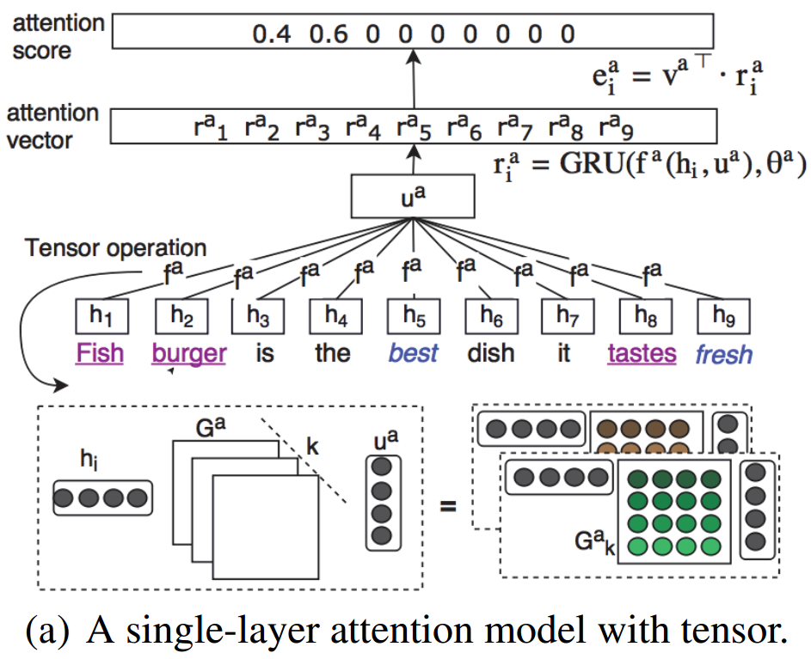
Model – Single attention
Figure1: A single-layer attention model with tensor

Slide 11

Model – Single attention
Composition vector:
Figure1: A single-layer attention model with tensor

Slide 12

Model – Single attention
Composition vector:
Attention vector:
Figure1: A single-layer attention model with tensor

Slide 13

Model – Single attention
Composition vector:
Attention vector:
Attention score:
Figure1: A single-layer attention model with tensor

Slide 14
Model – Coupled attentions
One for aspects extraction, the other for opinions extraction
They are learned interactively such that label information can be dually propagated among aspect terms and opinion terms by exploiting their relations.

Slide 15
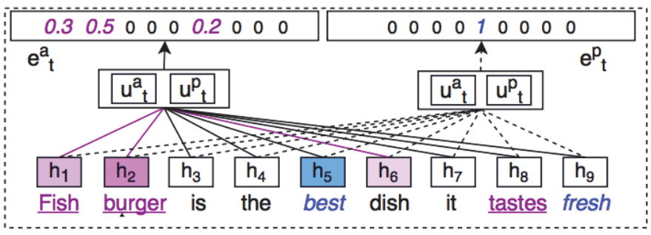
Model – Coupled attentions
Figure2: Coupled attention

Slide 16

Model – Coupled attentions
Attention vector
Notes:
这样学出来的组合向量也表征了每个词和opinion的关系

Slide 17
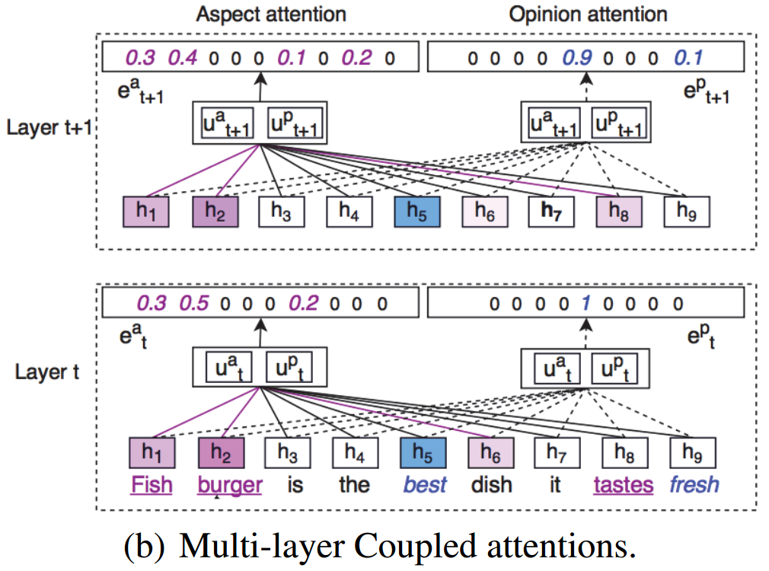
Model – Multi-layer coupled attentions
Figure3: Multi-layer Coupled attentions

Slide 18
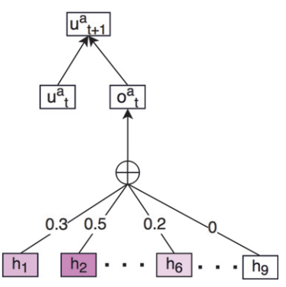

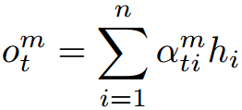
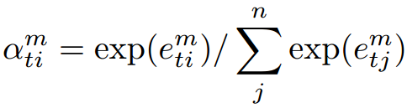
Model – Multi-layer coupled attentions
Prototype vector:
Figure4: Attention prototype

Slide 19
Outline
Background
Model
Experiments

Slide 20
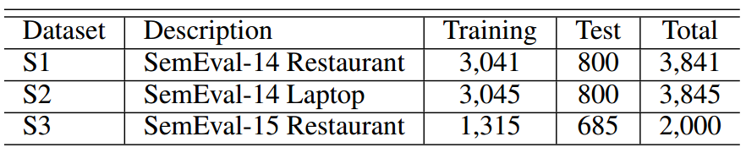
Experiment
Dataset
Tabel1: Dataset description

Slide 21
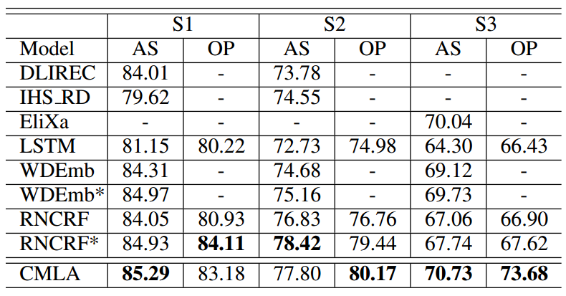
Experiment
Result
Tabel2: Comparison results in terms of F1 scores

Slide 22
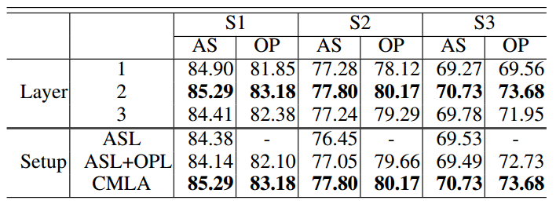
Experiment
Result
Tabel3: Comparison under varying layers and setups

Slide 23
Thank you!

